Slide 1
Finding the best place to put a Fast Food restaurant in Toronto
MARIANO SORIA
22/03/21

Slide 2
Requirements
Be near universities campus
Be accesible by students
Have space to park your bicycle
Competition is not a problem for the branch

Slide 3
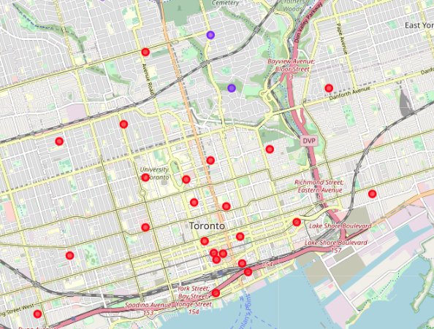
Venues clusters
Red clusters on the map represent the places with the higher density of venues
There are a low amount of fast food restaurants in the zone, only a couple near University Avenue and College Street.
The walk from the train station to the universities provide potential customers

Slide 4
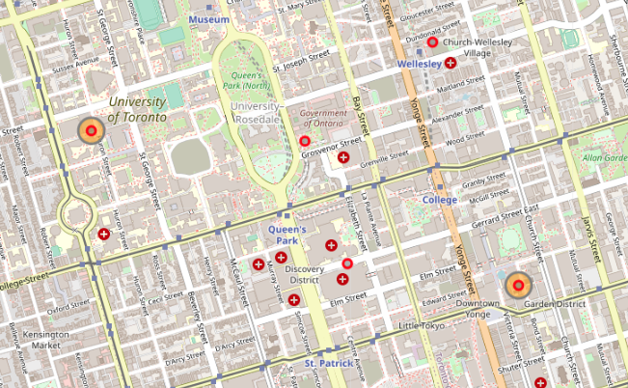
Universities and campus locations
Here we can see how the University of Toronto and Ryerson University are close. Giving the potential to have a high customer rate (Orange circles).

Slide 5
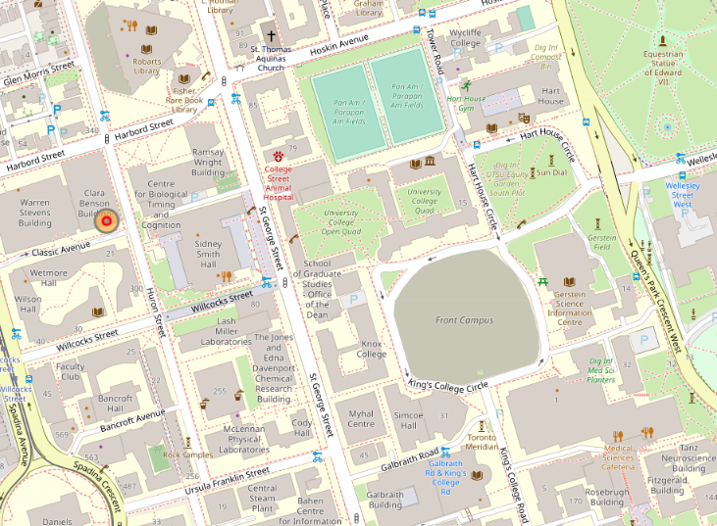
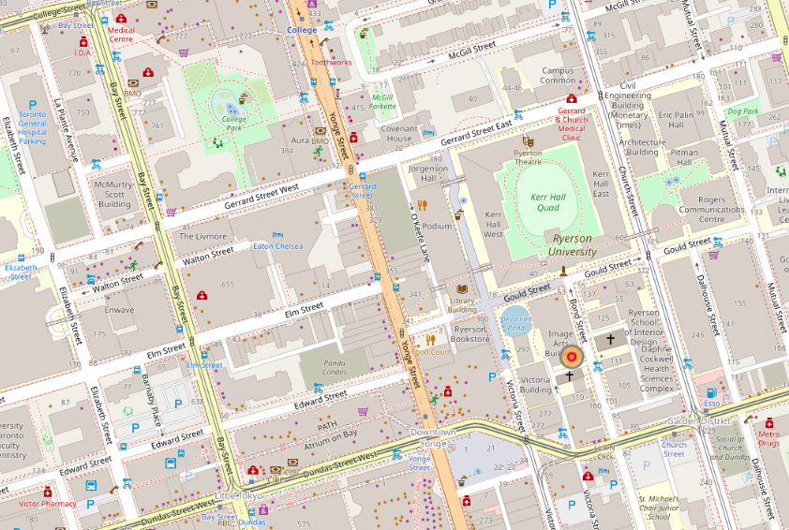
University map with more detail
University of Toronto
Ryerson University

Slide 6
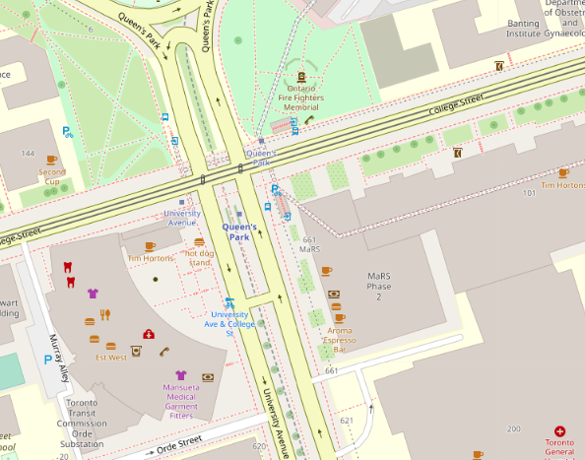
Detailed intersection and proposed location

Slide 7
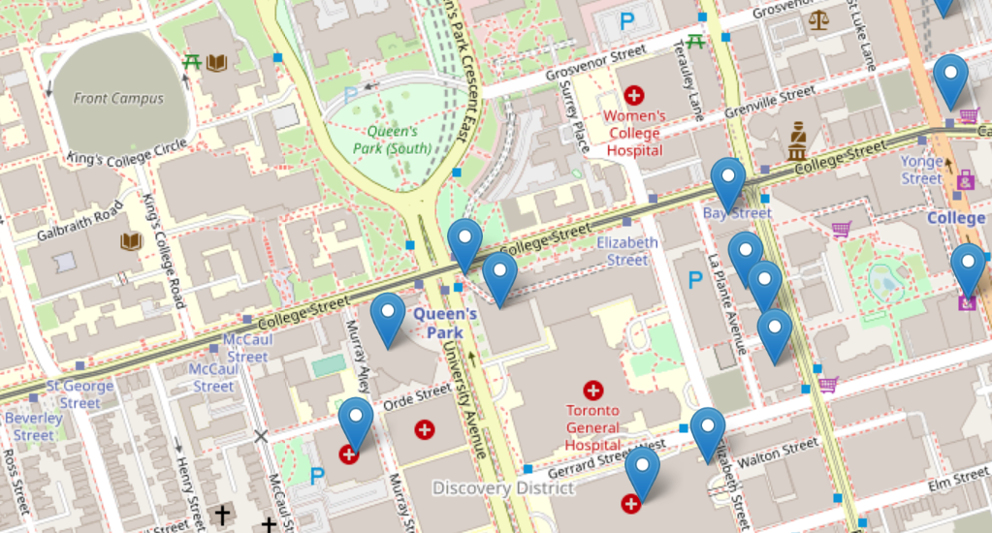
Bicycle Parking Spots

Slide 8
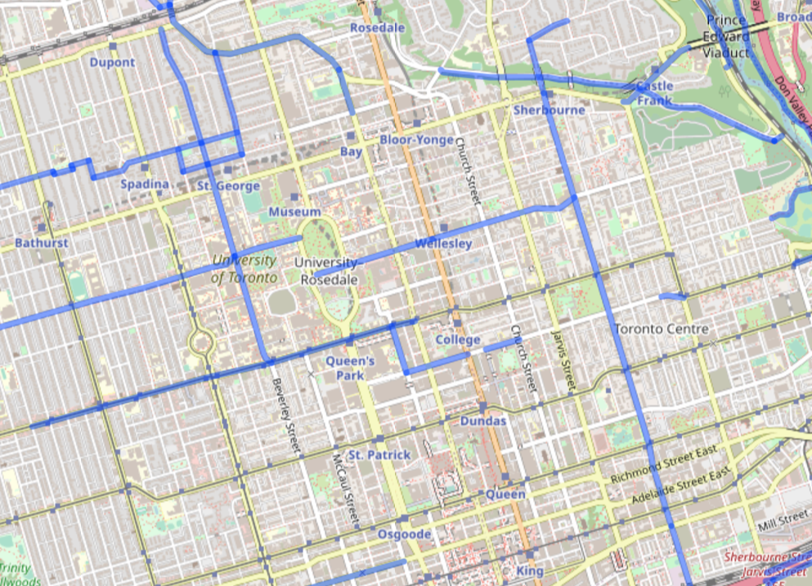
Bikeways near the zone

Slide 9
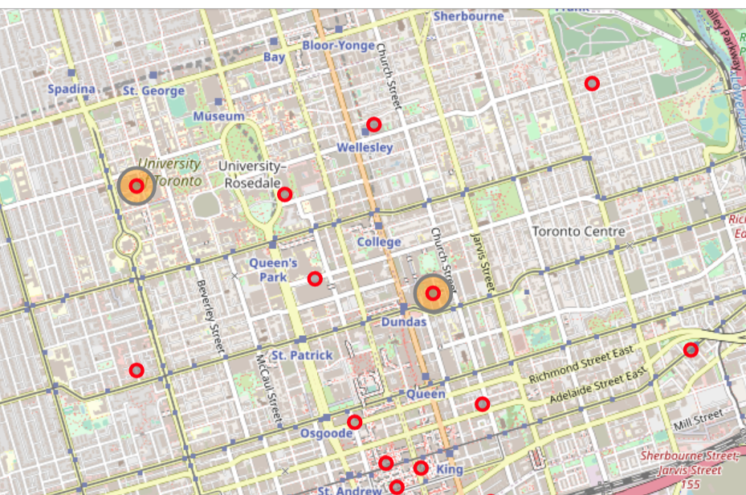
Global map of proposed location

Slide 10
Conclusion
The best place to put the first restaurant, given the requisites, it’s in the interjection between University Avenue and College Street
Competition is to be expected in that area, but the flow of students there should bring solid profit to the commerce
Expansion is posible by going down (South) in University Avenue. Restaurant will be closer to the train station which bring a constant flow of potential customers.

